Slide 1
RE 1: Randomization
UIUC ECON 474 Econometrics of Policy Evaluation

Slide 2
Today
Reading for next class: Ch 5.1, 5.2, 5.3.3, 5.3.4, 5.3.6
A Randomized experiment example:
Discuss and replicate part of part 1 of Thornton (2008)

Slide 3
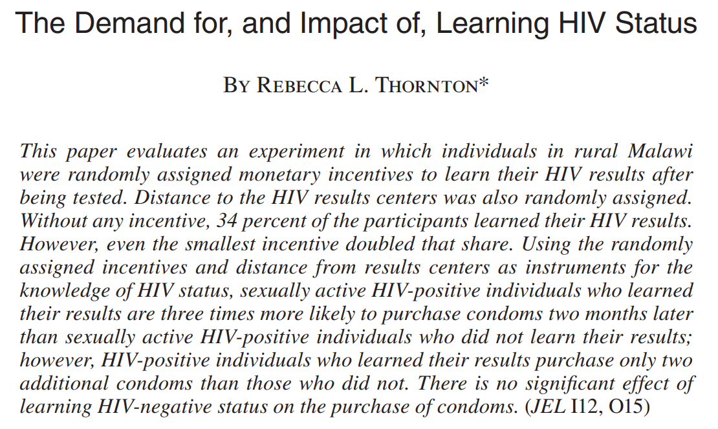
Thornton (2008)

Slide 4
Motivation – Testing assumptions
“First, many believe that knowledge of HIV status has positive effects on sexual behavior that prevent the spread of the disease. In particular, it is assumed that those diagnosed HIV-negative will protect themselves from infection and those diagnosed HIV-positive will take precautions to protect others.”
“Second, many believe that it is difficult to get people to learn their HIV status, due primarily to psychological or social barriers, thus justifying expenditures on destigmatization and advertising campaigns.”

Slide 5
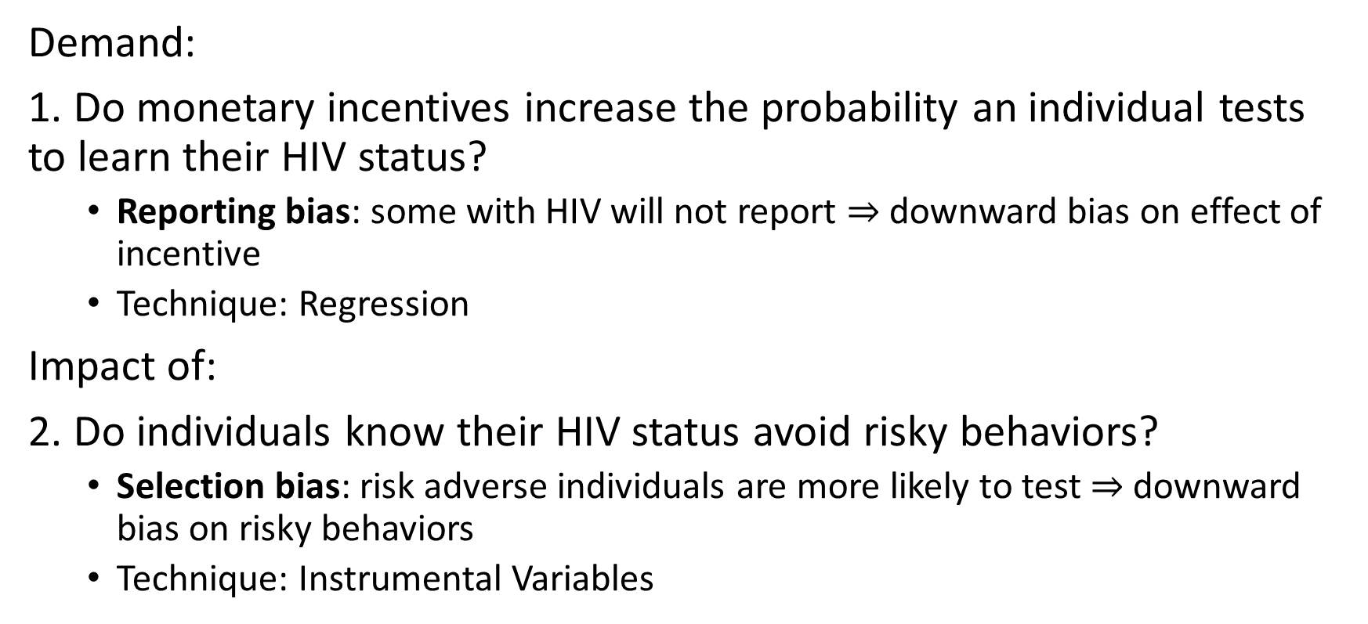
Two-fold research question & obs. data issues
Demand:
1. Do monetary incentives increase the probability an individual tests to learn their HIV status?
Reporting bias: some with HIV will not report $⇒$ downward bias on effect of incentive
Technique: Regression
Impact of:
2. Do individuals know their HIV status avoid risky behaviors?
Selection bias: risk adverse individuals are more likely to test $⇒$ downward bias on risky behaviors
Technique: Instrumental Variables

Slide 6



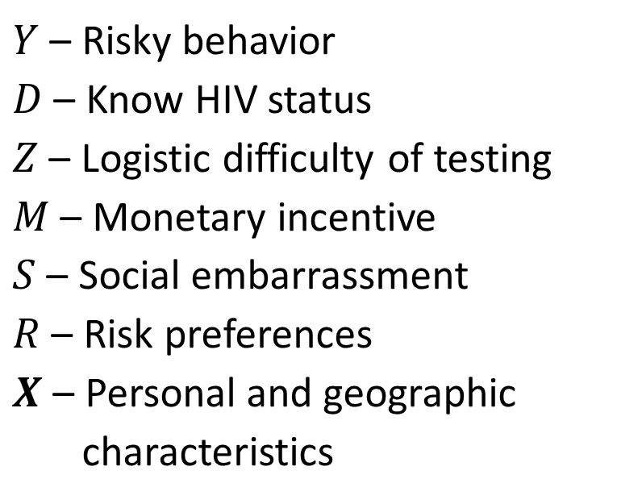




DAG – My interpretation
$$Z$$
$$S$$
$Y$ – Risky behavior
$D$ – Know HIV status
$Z$ – Logistic difficulty of testing
$M$ – Monetary incentive
$S$ – Social embarrassment
$R$ – Risk preferences
$X$ – Personal and geographic
characteristics
$$M$$
$$D$$
$$Y$$
$$X$$
$$R$$

Slide 7
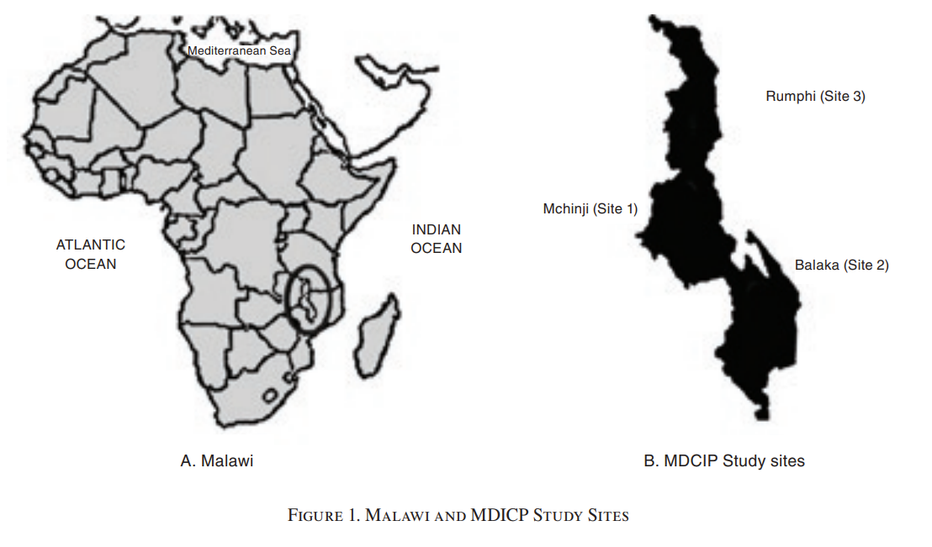
Experimental Design
Setting: Malawi
119 villages from three districts
25% of HH in village randomly selected to participate
Random selection: 1998
Interviews: 1998, 2001, 2004
HIV and STI test offered: 2004
Some accepted test
Randomly assign cash voucher to learn results at later date

Slide 8
Learning about results mechanism
Two to four months later, test results become available at temporary Voluntary Counselling and Testing (VCT) centers (small portable tents)
VCTs are randomly placed within 5.2 km of each village
Two months after learning results, tested respondents were
Reinterview for risky sexual behaviors
Paid ~$0.30 as appreciation for participation
Offered to buy up to 18 condoms only with the $0.30

Slide 9
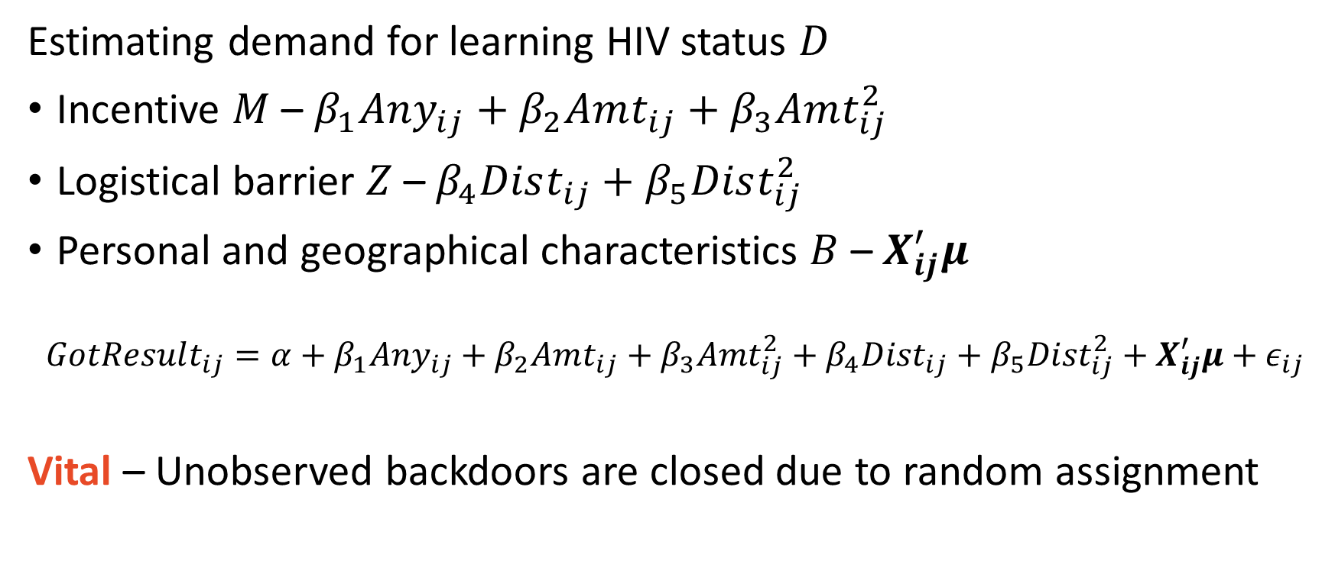
Empirical Design
Estimating demand for learning HIV status $D$
Incentive $M$ – $β_{1}Any_{ij}+β_{2}Amt_{ij}+β_{3}Amt_{ij}^{2}$
Logistical barrier $Z$ – $β_{4}Dist_{ij}+β_{5}Dist_{ij}^{2}$
Personal and geographical characteristics $B$ – $X_{ij}^{′}μ$
$$GotResult_{ij}=α+β_{1}Any_{ij}+β_{2}Amt_{ij}+β_{3}Amt_{ij}^{2}+β_{4}Dist_{ij}+β_{5}Dist_{ij}^{2}+X_{ij}^{′}μ+ε_{ij}$$
Vital – Unobserved backdoors are closed due to random assignment

Slide 10
A quick technical note
Which we will discuss in much more detail later on in the course

Slide 11
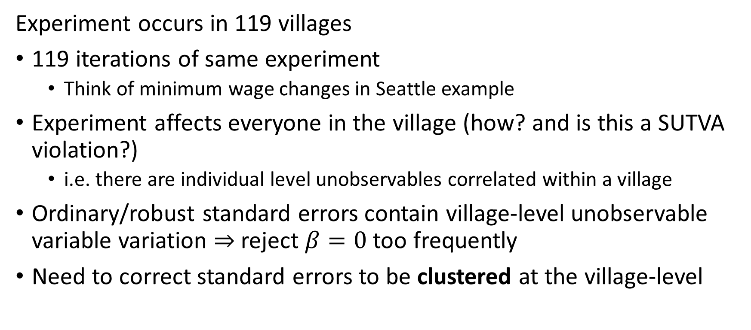
Clustered Standard Errors
Experiment occurs in 119 villages
119 iterations of same experiment
Think of minimum wage changes in Seattle example
Experiment affects everyone in the village (how? and is this a SUTVA violation?)
i.e. there are individual level unobservables correlated within a village
Ordinary/robust standard errors contain village-level unobservable variable variation $⇒$reject $β=0$ too frequently
Need to correct standard errors to be clustered at the village-level

Slide 12
What we are replicating
To the best of Julian’s Stata to R code translation abilities

Slide 13
Two tables and a figure
A treatment status balance table (not in the paper)
The OLS results from table 4
Figure 3

Slide 14
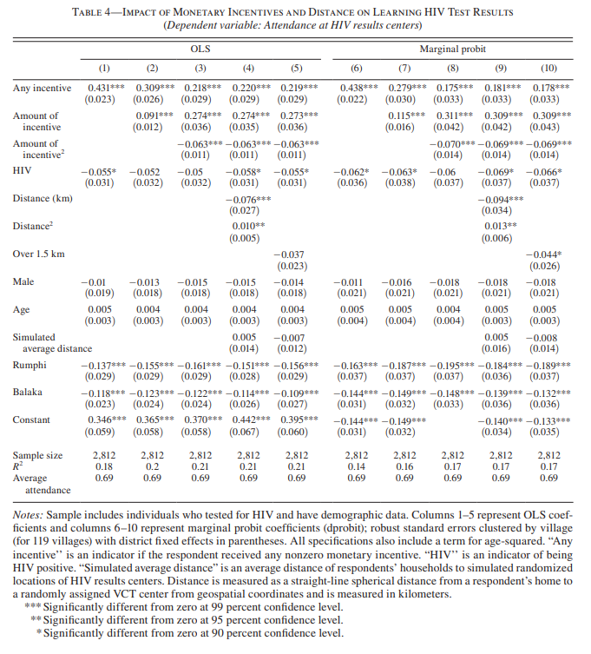
Table 4

Slide 15
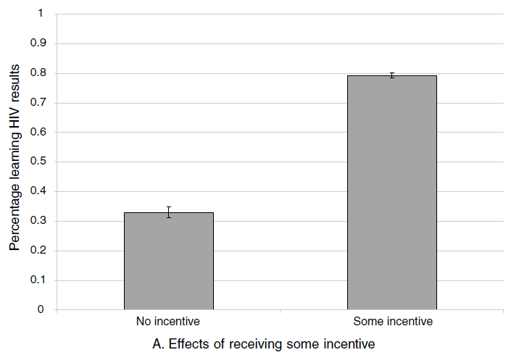
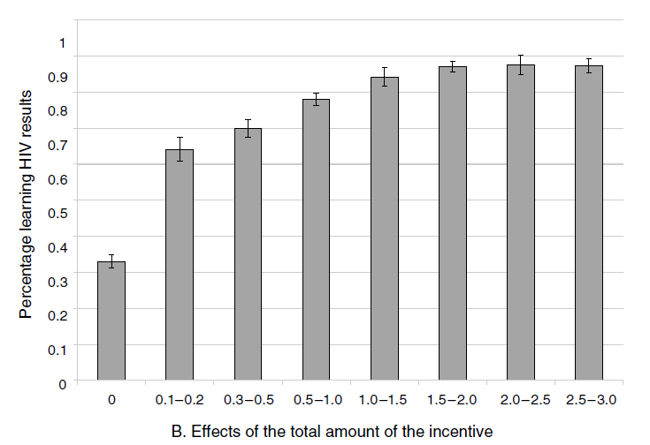

Figure 3

